Slide 1
Exercises: Storm-time IT Reponses
using CTIPe runs with artificial conditions
Local Network:
http://10.0.1.5/support/ILWS/runs.php
Internet:
http://ccmc.gsfc.nasa.gov/support/ILWS/runs.php
Click here

Slide 2
Thermosphere/Ionosphere Lab (Tim Fuller Rowell, NOAA): http://ccmc.gsfc.nasa.gov/support/ILWS/TUTORIALS/Fuller-Rowell_Helio_Lab2010.pdf

Slide 3
CTIPe Model
Coupled Thermosphere Ionosphere Plasmasphere Electrodynamics Model:
Forcing: solar UV and EUV, Weimer electric field, TIROS/NOAA auroral precipitation, tidal forcing
Example model output parameters on pressure levels
plasma density N_e [m⁻³], TEC [TECU]
neutral wind [m/s] (meridional Vn_lat positive south, zonal Vn_lon positive east, vertical Vn_IP positive up),
temperature T_n [K],
mean molecular mass Rmt [amu], mass density rho [kg/m³],
height of pressure level H [m]
Joule heating Pjoule [J/(kg s)], height-integrated Joule heating Wjoule [mW/ m²]
rd(variable): change in variable = storm time – quiet time
Approximate altitudes: pressure level 1 (80km, lower boundary), level 3 (90km), level 5 (103km), level 6 (110km), level 7 (120 km, E-region ionosphere), level 8 (135km), level 9 (160km), level 12 (300 km, F-region ionosphere)
Model outputs also on height levels

Slide 4
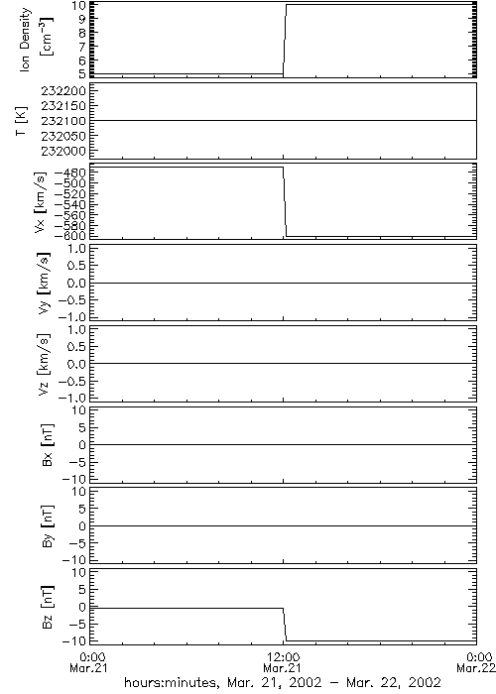
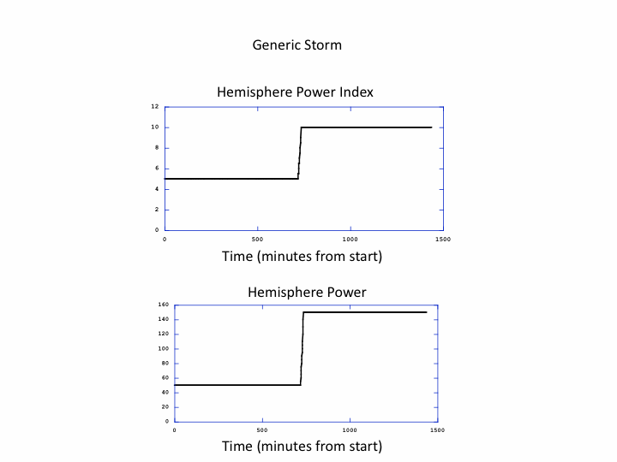
Generic Magnetospheric Forcing
Generic equinox storm:
12 hr increase in magnetospheric sources (Bz= -10 nT, |Vx|= 600 km/s, n= 10/cm³, HPI=10, HP=150 GW), Kp~8, and return to quiet levels (Bz= -0.42 nT, |Vx|= 470 km/s, n= 5/cm³, HPI=5, HP=50) for recovery.
Storm commence at 12UT on 03/21.
Moderate solar activity F10.7~150.
Notes:
The Hemispheric Power Index is an estimate of the total hemispheric energy flux in GW of precipitating auroral electrons (
Emery et al. (2008), J. Geophys. Res.,113, A06311, doi:10.1029/2007JA012866.

Slide 5
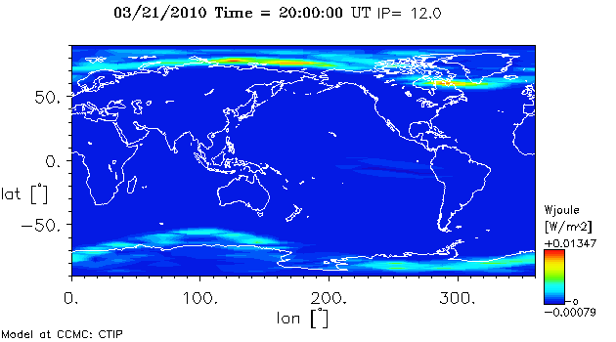
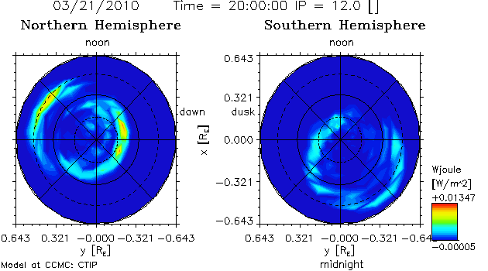
Exercise 1: Magnetospheric Energy Deposition by Joule Heating
Below is an example of magnetospheric energy deposition into ionosphere-thermosphere (IT) system from Joule Heating for a quiet time period (Bz= -0.42 nT, |Vx|= 470 km/s, n= 5/cm³, HPI=5, HP=50). Use the CTIPe equinox simulation of a generic storm. Plot the height-integrated Joule heating (Wjoule) and Joule heating change (rdWjoule) across the globe or polar regions as in the example below. What is the typical peak magnitude of the magnetospheric energy deposition by Joule Heating during a storm? What is the typical percentage increase?

Slide 6
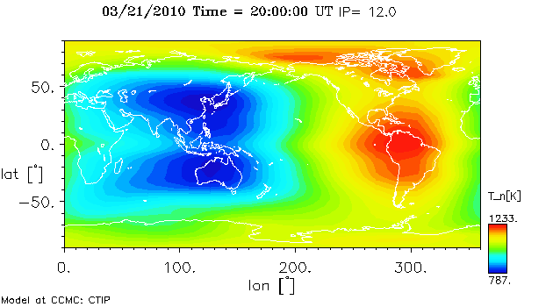
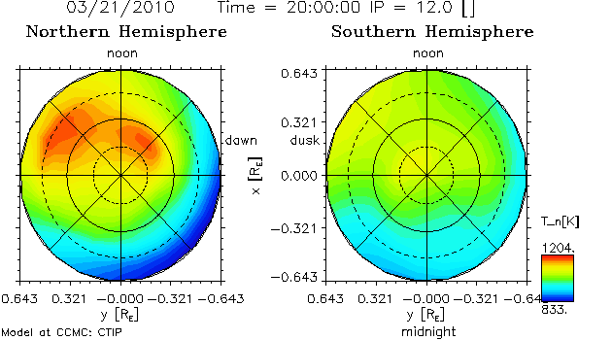
Exercise 2: Temperature Changes during Storms
The magnetospheric energy from Joule heating raises the temperature as well as the neutral density of the thermosphere. What is the typical peak temperature increase in the upper thermosphere during a geomagnetic storm (50K, 100K, 500K, 1000K.?). Plot the temperature change (rdT_n) on pressure level 12 across the globe 8 hours after storm onset using the equinox generic storm simulation and compare with the temperature before the storm, or quiet case, as in the example below. What is the typical percentage increase (5%, 10%, 50%, 100%?).

Slide 7
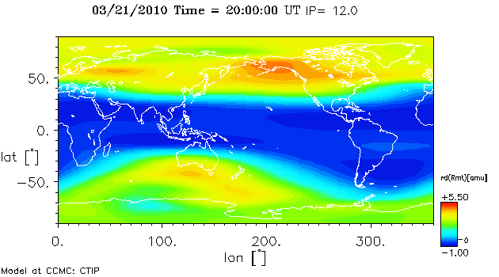
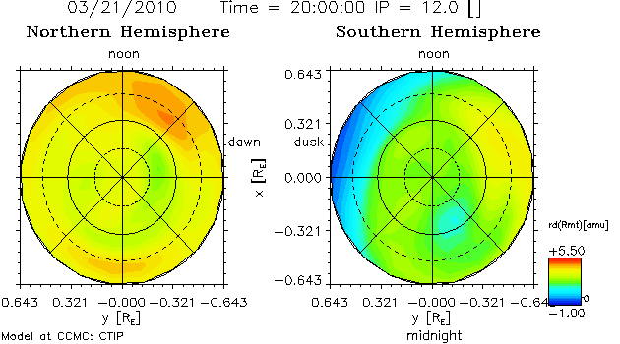
Exercise 3: Neutral Composition Response during Storms
Compare the neutral composition response (change in mean molecular mass, rd_Rmt) after 8 and12 hours in the equinox generic storm case at pressure level 12.
Which neutral parameter at mid and high latitude has the strongest correlation with plasma density changes (temperature, mean mass composition, meridional winds, zonal winds)? Compare change in NmF2, rd(NmF2) or TEC (rdTEC) with changes in neutral parameters.

Slide 8
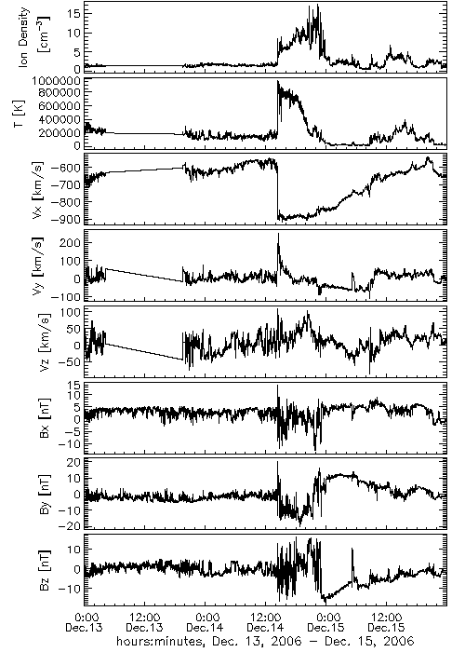
Exercise 4: 2006 AGU Storm event
Use the “real” storm simulation (GEM_CEDAR_091815_IT_2), 2006 Dec event, to see if the same physical processes appear to be operating. Repeat Exercise 1-3 for 2006 Dec event. How easy is it to interpret simulation of real events rather than generic storms?
Solar wind plasma data and IMF data
during 2006 Dec. event

Slide 9
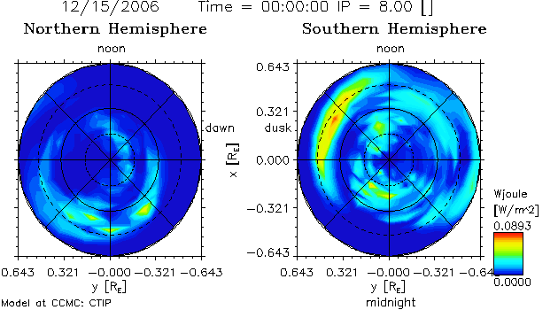
Exercise 5: Effects of high latitude drivers on IT system
Use the “real” storm simulations of CTIPe, GEM_CEDAR_091815_IT_2 (with Weimer2005 electric potential) and GEM_CEDAR_100215_IT_1 (with electric potential obtained from SWMF). Compare the height-integrated Joule heating (Wjoule) of the two simulations using “polar plot” as in the example below.
Compare the IT parameters (temperature, neutral mass density, NmF2, TEC, and etc.) and changes in the parameters (rdTn, rd(rho), and etc) of the two simulations with different high-latitude electric potential models.

